Slide 1

WORLD HAPPINESS REPORT ANALYSIS
Group 4: Data Vizards
Shashank Ahuja Anirudh Bhagat Tushar Mallya Priya Patil Anuja Phadtare Himanshu Vaishnav Aaliya Yunus

Slide 2

Introduction
Goals of Analysis
Dataset Data Elements
Analysis Methods Used
Data Visualization Methods
Conclusion

Slide 3

INTRODUCTION
Starting from 2012, every year United Nations Sustainable Development Solutions Network releases the World Happiness Report that states which country is ranked “happiest” in the whole world
Happiness is progressively considered an appropriate measure of social progress and the goal of public policy
In this report, we give consideration to the variation of happiness across countries based on 6 key factors
The Happiness Score was constructed by taking the data from Gallup World Poll

Slide 4

Goals of Analysis
We wish to do the analysis to find the following:
Countries ranking highest in happiness from the time period 2015, 2016 and 2017
Any significant changes in the Happiness Score of countries
Major key factors contributing to the Happiness Score
Tools Used: STATA, SAS JMP

Slide 5
DATASET DATA ELEMENTS
Dependent Variable
Independent Variables ( Six key factors )
Economy GDP per capita: Purchasing power of an individual
Health life expectancy: Individual's life expectancy
Family: Quality of family life of an individual
Trust: Government's measure of corruption
Freedom: Freedom of an individual to make life decisions
Happiness Score
Country: Countries in consideration
Dystopia: An imaginary country with the lowest happiness score/rank. This acts as a baseline for conducting our analysis
Other factors
Generosity: How generous is the population in terms of charity

Slide 6


ANALYSIS METHODS USED
STATA:
Descriptive
Correlation
Multiple Linear Regression
Interaction Term Analysis
SAS JMP:
K-means Clustering

Slide 7
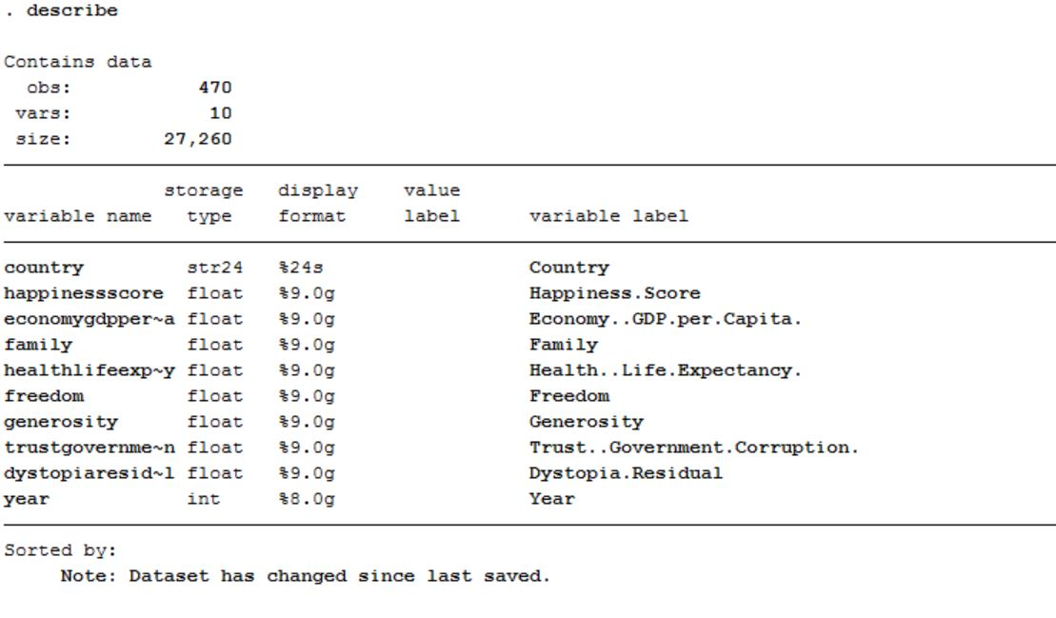
DESCRIPTION OF DATA

Slide 8
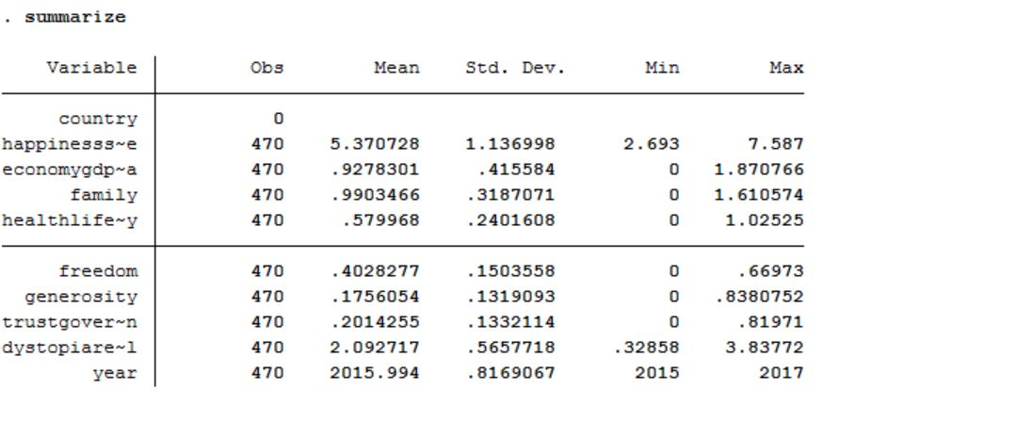
SUMMARY OF DATA

Slide 9
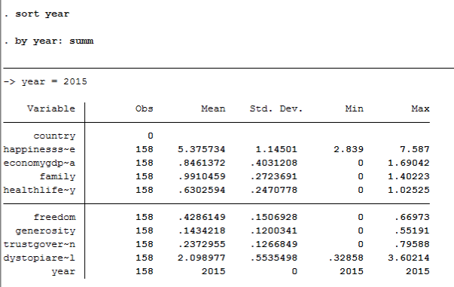
SUMMARY 2015

Slide 10
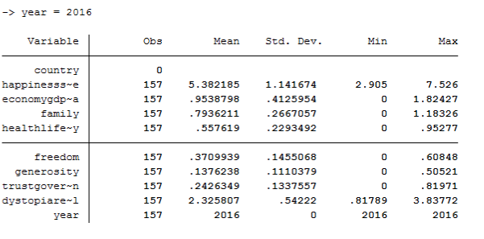
SUMMARY 2016

Slide 11
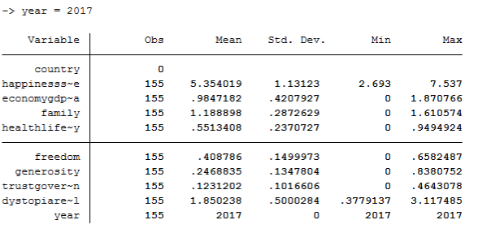
SUMMARY 2017

Slide 12
KEY POINT INDICATORS
The mean of Happiness Score has not changed significantly over the years 2015 – 2017 (~5.370)
There is an increase in the mean Economy GDP across the years
The mean of Generosity has remained the same during the years 2015 – 2016 (0.143, 0.137), but increased during 2017 (0.246)
There is a decrease in the mean Life Expectancy across the years

Slide 13
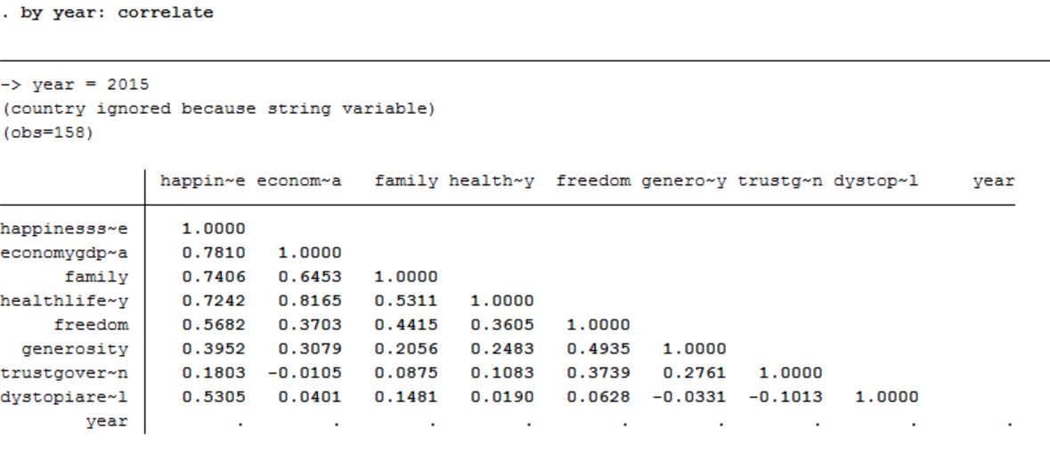
CORRELATION 2015

Slide 14
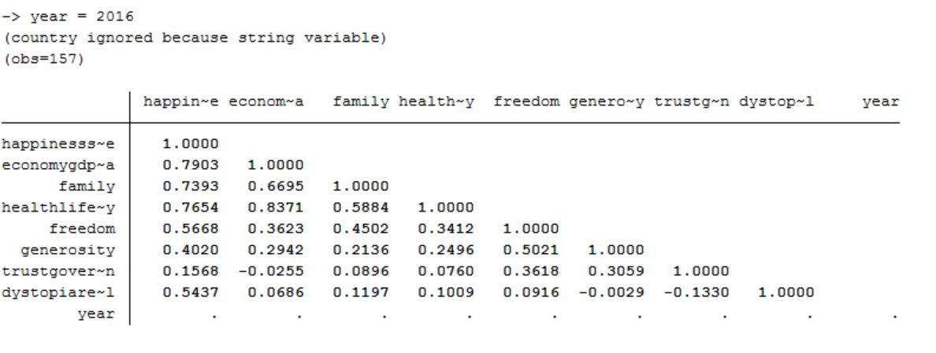
CORRELATION 2016

Slide 15
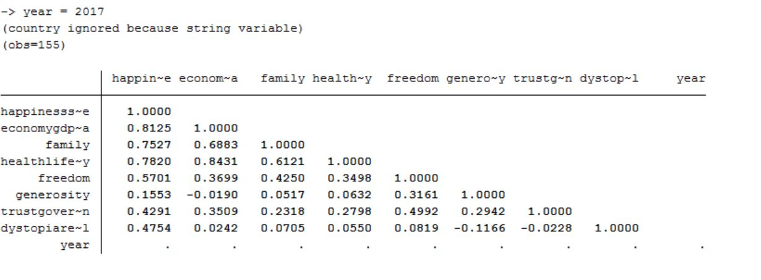
CORRELATION 2017

Slide 16
CORRELATION: KPIs
Positive Correlation between Economy GDP Per Capita and Happiness Score. The correlation value increases over the years (0.781 in 2015, 0.7903 in 2016 and 0.8125 in 2017)
Strong Positive Correlation between Economy GDP Per Capita and Health Life Expectancy. The correlation value increases over the years (0.816 in 2015, 0.8371 in 2016, 0.8431 in 2017)

Slide 17

REGRESSION ANALYSIS
Using the available data and exploring different data analysis methods, we identified "Multiple Linear Regression Analysis" is the best fit for our analysis
Multiple linear regression is used to explain the relationship between one continuous dependent variable and two or more independent variables
With respect to our dataset, we have a dependent variable Happiness Score which depends on other independent variables like Economy GDP per Capita, Health life expectancy, Freedom, Family, Trust

Slide 18
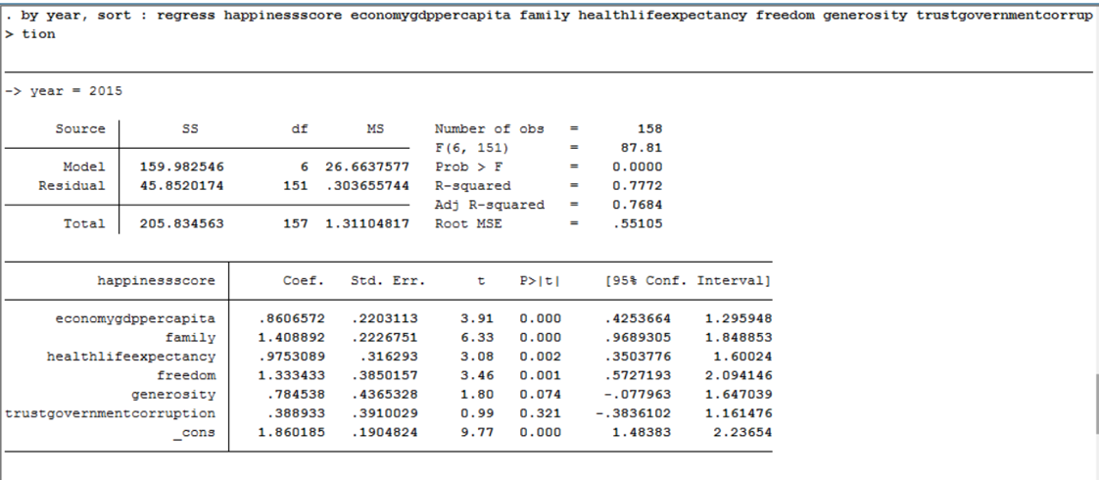
REGRESSION MODEL 2015

Slide 19
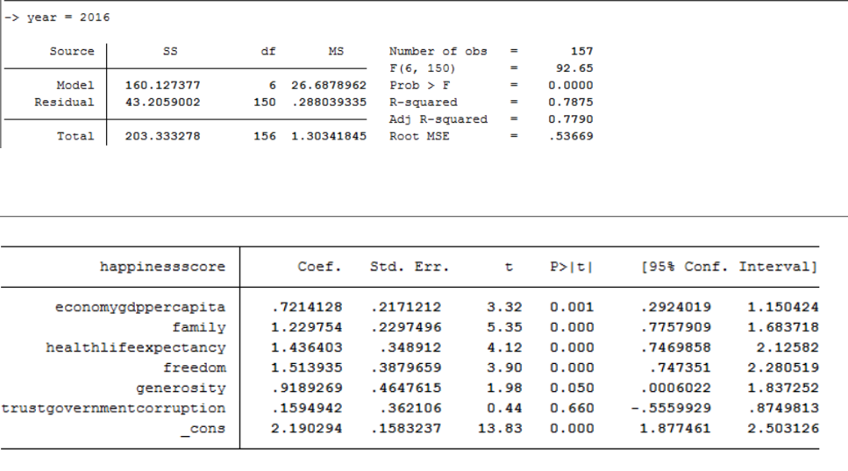
REGRESSION MODEL 2016

Slide 20
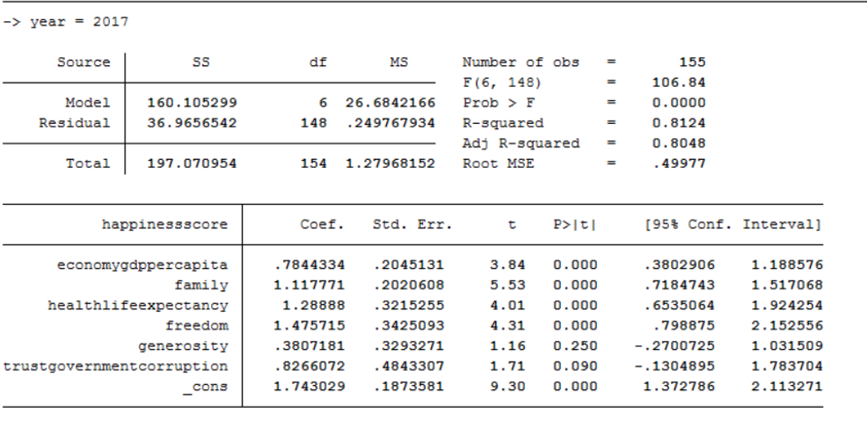
REGRESSION MODEL 2017

Slide 21
REGRESSION ANALYSIS: KPIs
Regression analysis for the years 2015, 2016 and 2017 indicates that
Economy GDP per capita, Life expectancy, Freedom and Family are statistically significant as their p-value < 0.05
Trust and Generosity are not statistically significant at 5% of significance level
R-Squared value is increasing over the years, which indicates an improved regression model

Slide 22
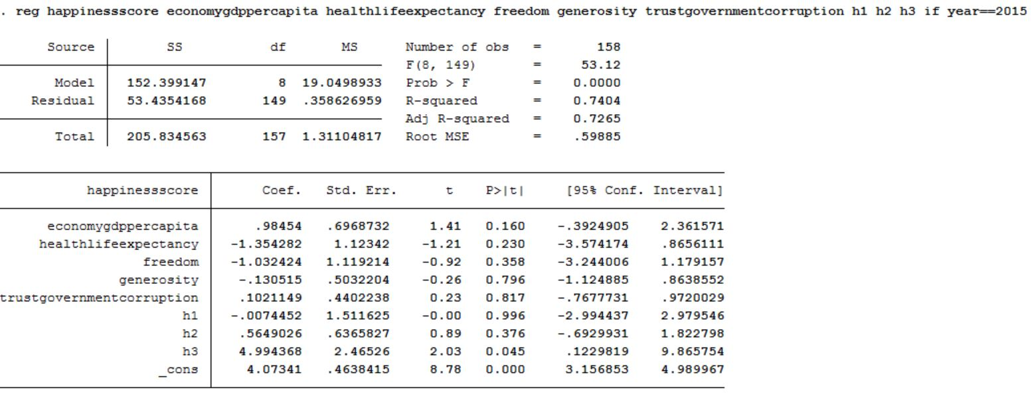
INTERACTION TERM ANALYSIS 2015
gen h1 = economygdppercapita * freedom
gen h2 = healthlifeexpectancy * economygdppercapita
gen h3 = healthlifeexpectancy * freedom

Slide 23
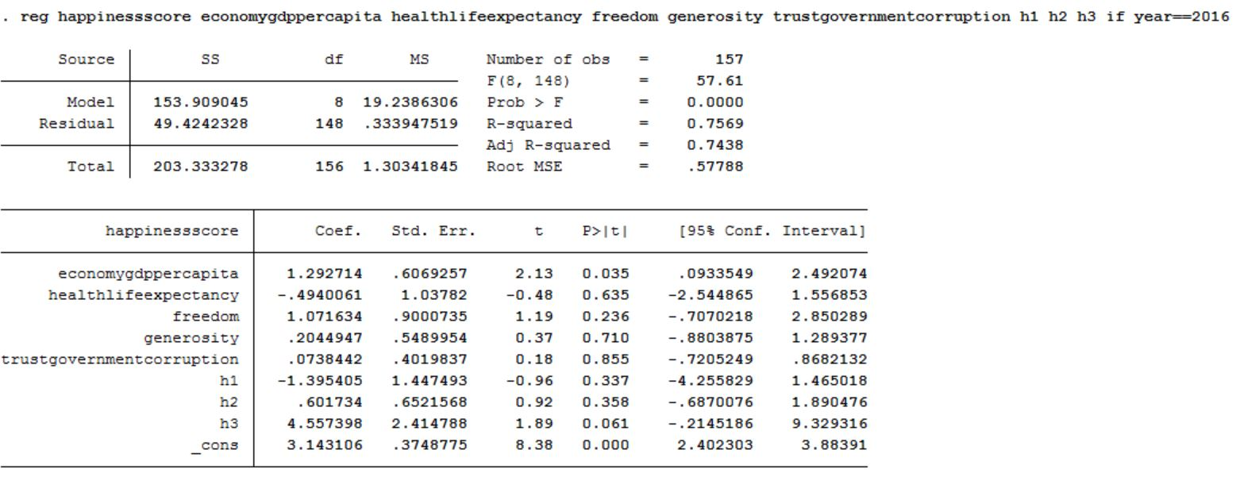
INTERACTION TERM ANALYSIS 2016

Slide 24
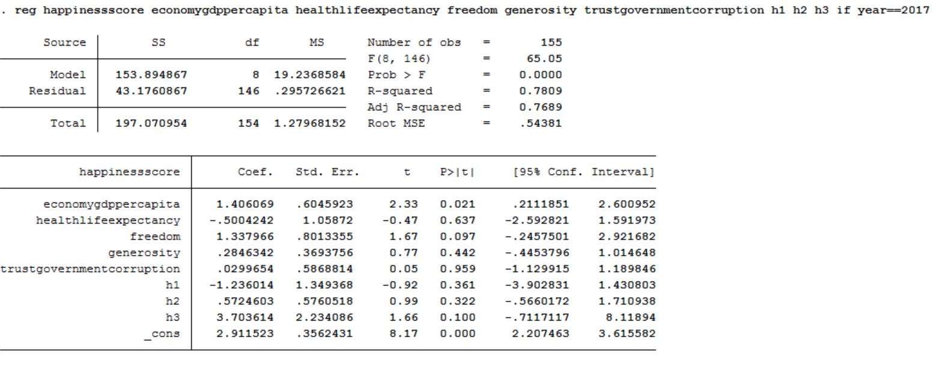
INTERACTION TERM ANALYSIS 2017

Slide 25
KEY POINT INDICATORS
Interaction term h3 has a significant impact on Happiness Score only during 2015, since the p-value < 0.05
Interaction terms h1 and h2 do not have a significant impact across all the years, since the p-value > 0.05

Slide 26
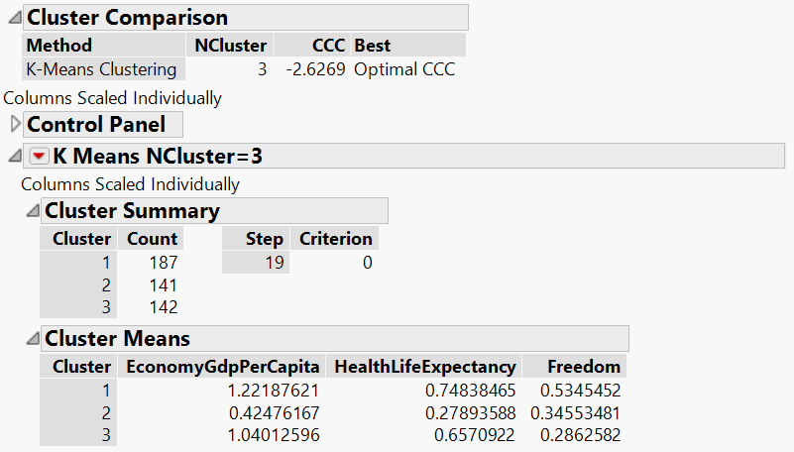
K-Means Clustering
Number of clusters = 3
Cluster 1 is performing best in EconomyGDPperCapita, HealthLifeExpentancy, and Freedom
Cluster 3 is performing moderately in EconomyGDPperCapita and HealthLifeExpentancy but performing poor in freedom compared to all
Cluster 2 is performing poor in EconomyGDPperCapita and HealthLifeExpectancy but for Freedom, it is performing better than cluster 3

Slide 27
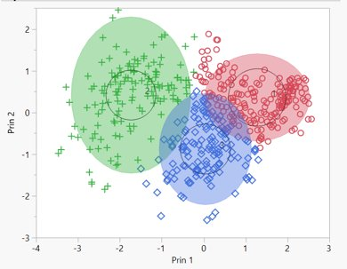

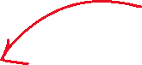

Cluster 1
Cluster 2
Prin 2
Cluster 3
Prin 1

Slide 28
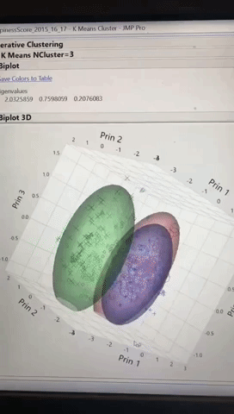
3D BIPLOT

Slide 29
STATA
Scatter Plots
Bar Graphs
SAS JMP
Heatmap
VISUALIZATION METHODS

Slide 30
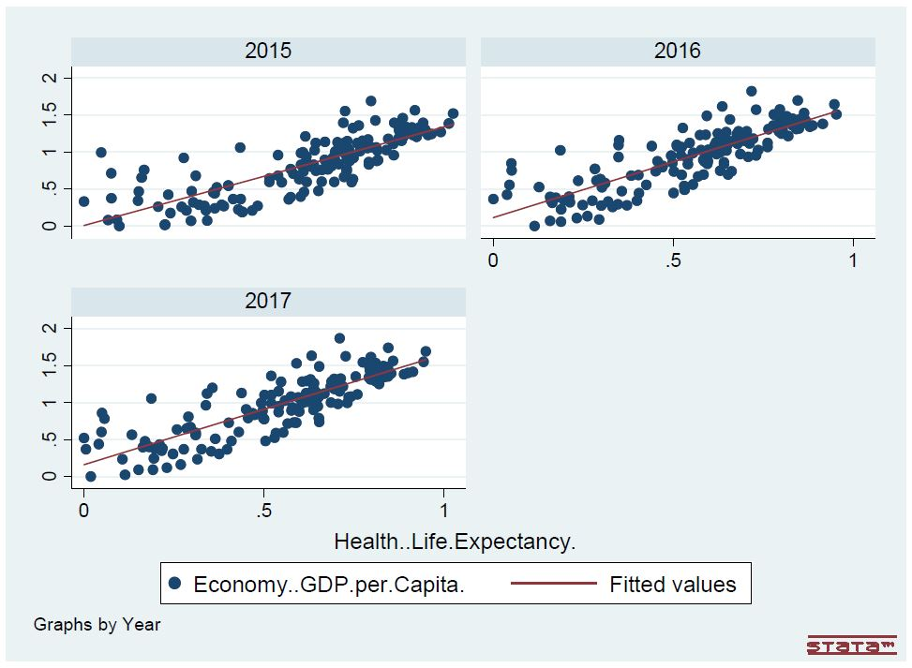
Scatter Plot: Economy GDP per Capita VS Health Life Expectancy

Slide 31
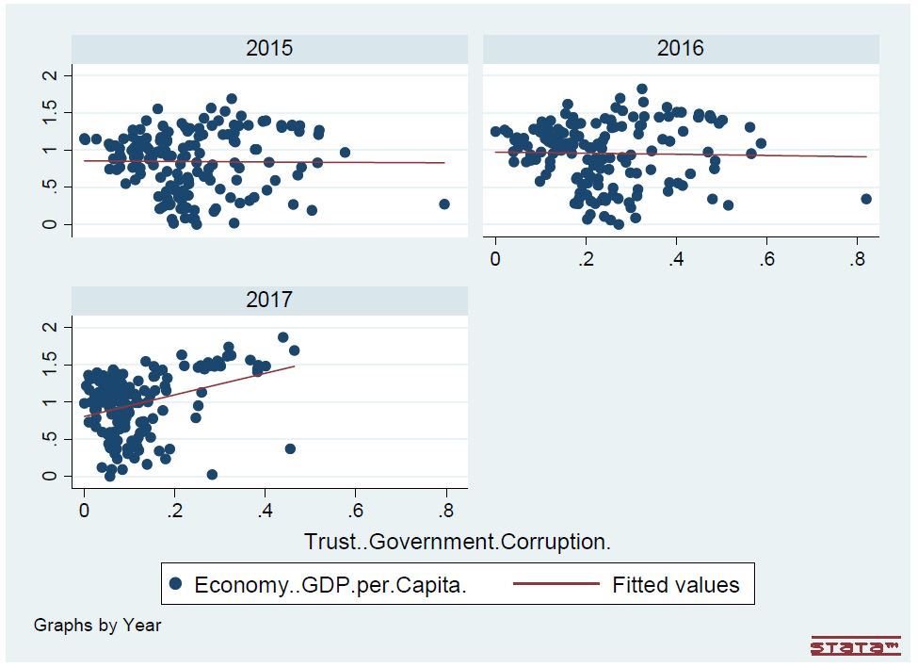
Scatter Plot: Economy GDP per Capita VS Trust

Slide 32
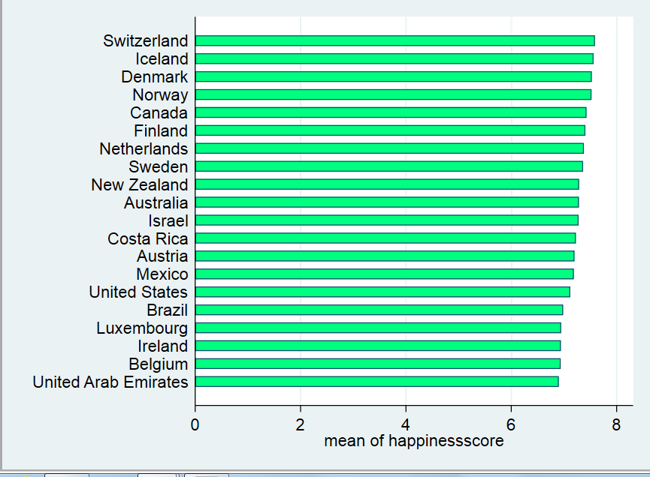
BAR GRAPHS:
Top 20 countries - 2015

Slide 33
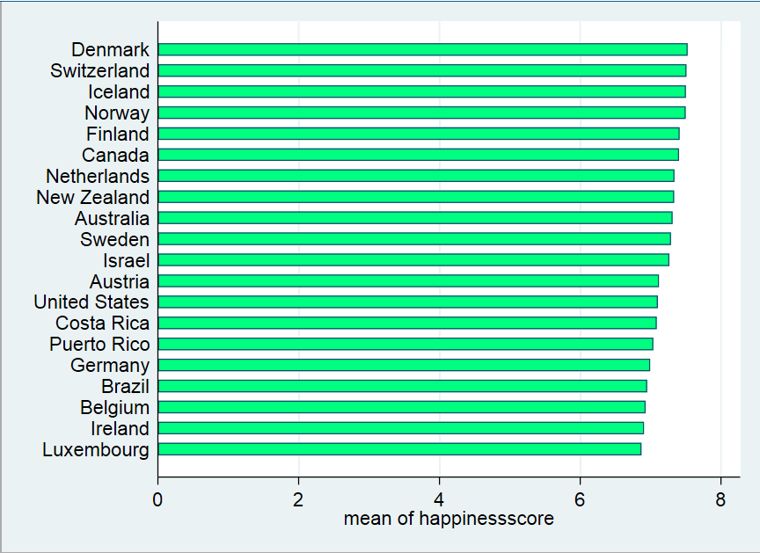
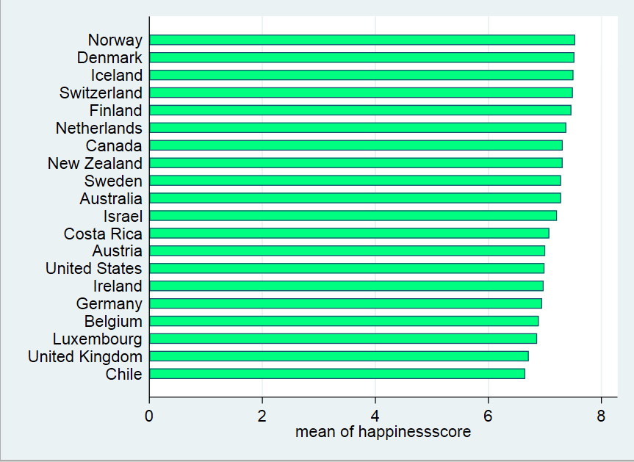
Top 20 countries - 2016
Top 20 countries - 2017

Slide 34
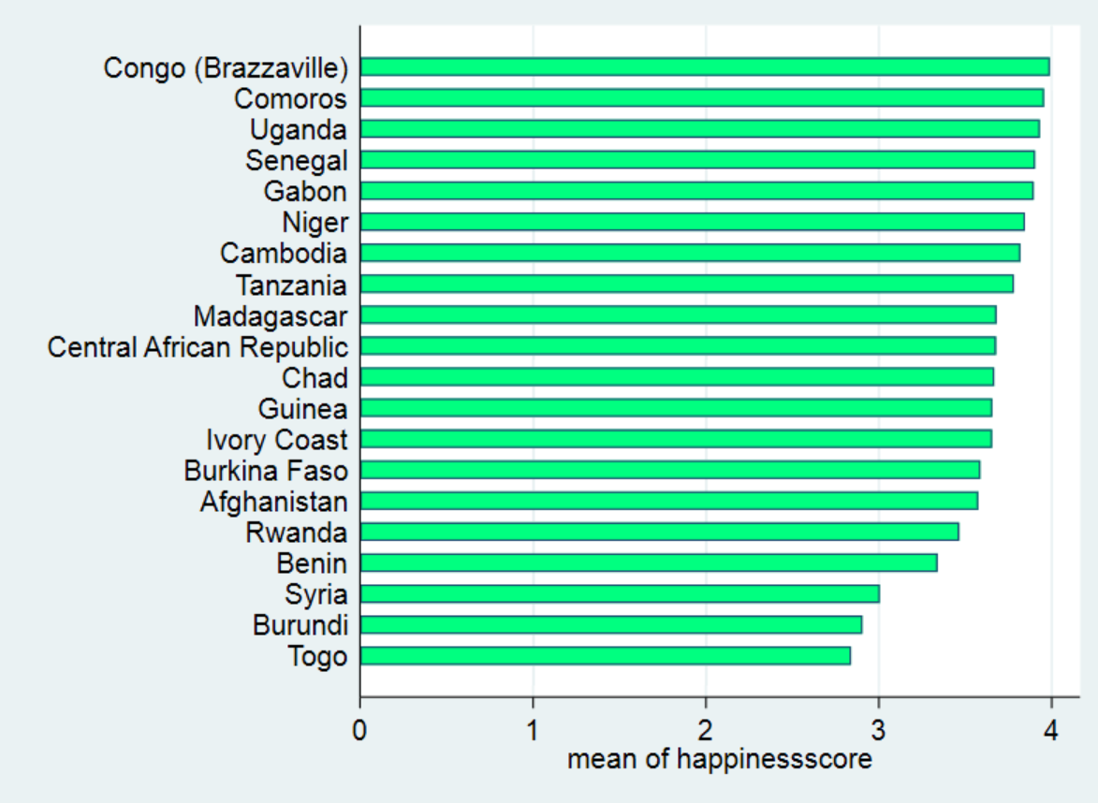
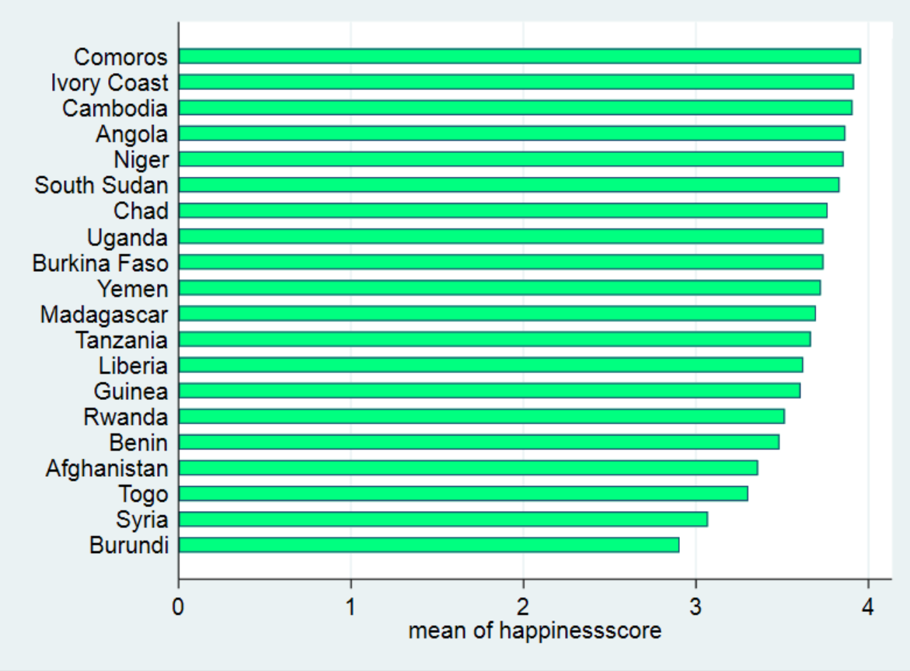
Bottom 20 countries 2015
Bottom 20 countries 2016

Slide 35
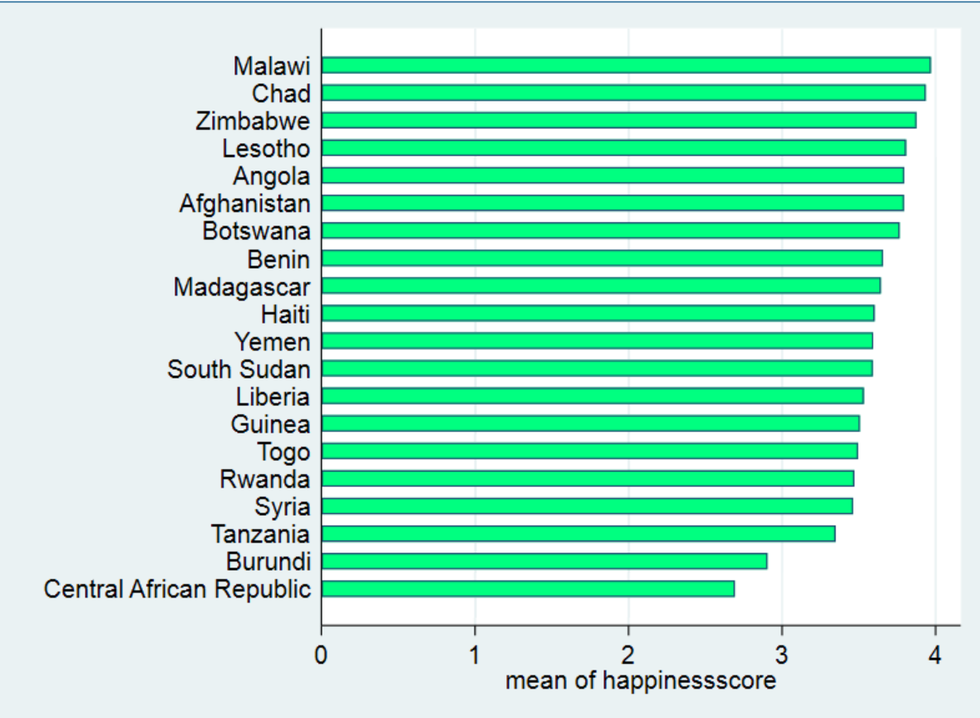
Bottom 20 countries 2017

Slide 36
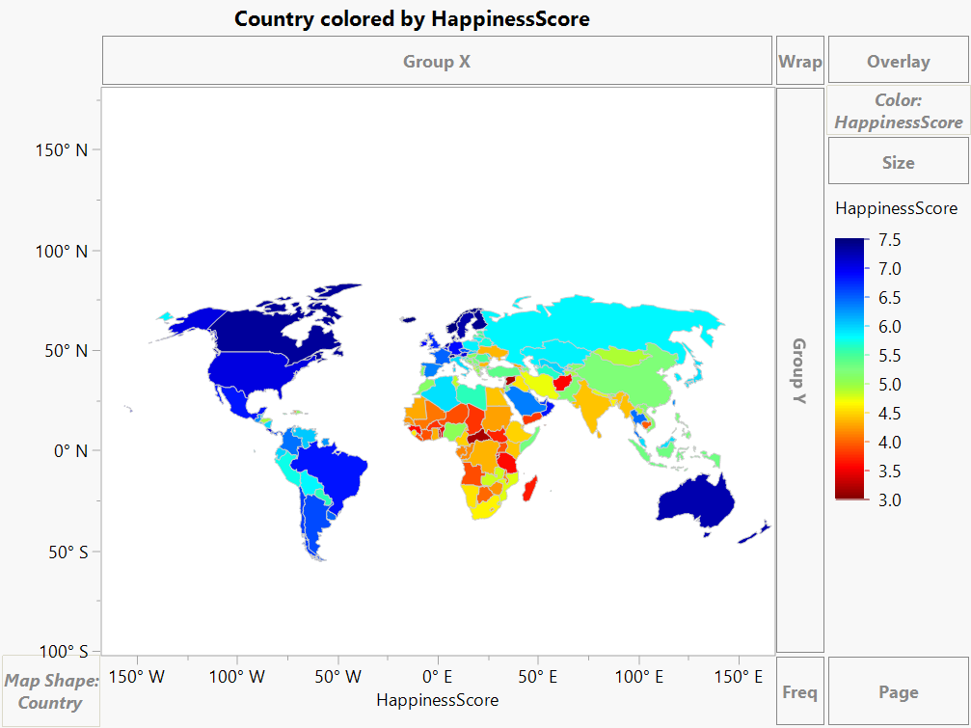
HEATMAP

Slide 37
Norway bagged the first position as the happiest country in the world as per the 2017 report.
It did so by investing their abundant natural resources into long term sustainable growth as opposed to short term gains
In 2015, 2016 and 2017, the top 5 countries merely changed
Significant Key Factors contributing to Happiness Score :
Economy GDP per Capita
Health life expectancy
Freedom
The specific analysis of USA ranking also concludes that American happiness is failing due to social rather than economic factors
GOALS ACHIEVED

Slide 38
CONCLUSION
Video

Slide 39

Do you live in a world that values and promotes happiness and wellbeing?

